Slide 1

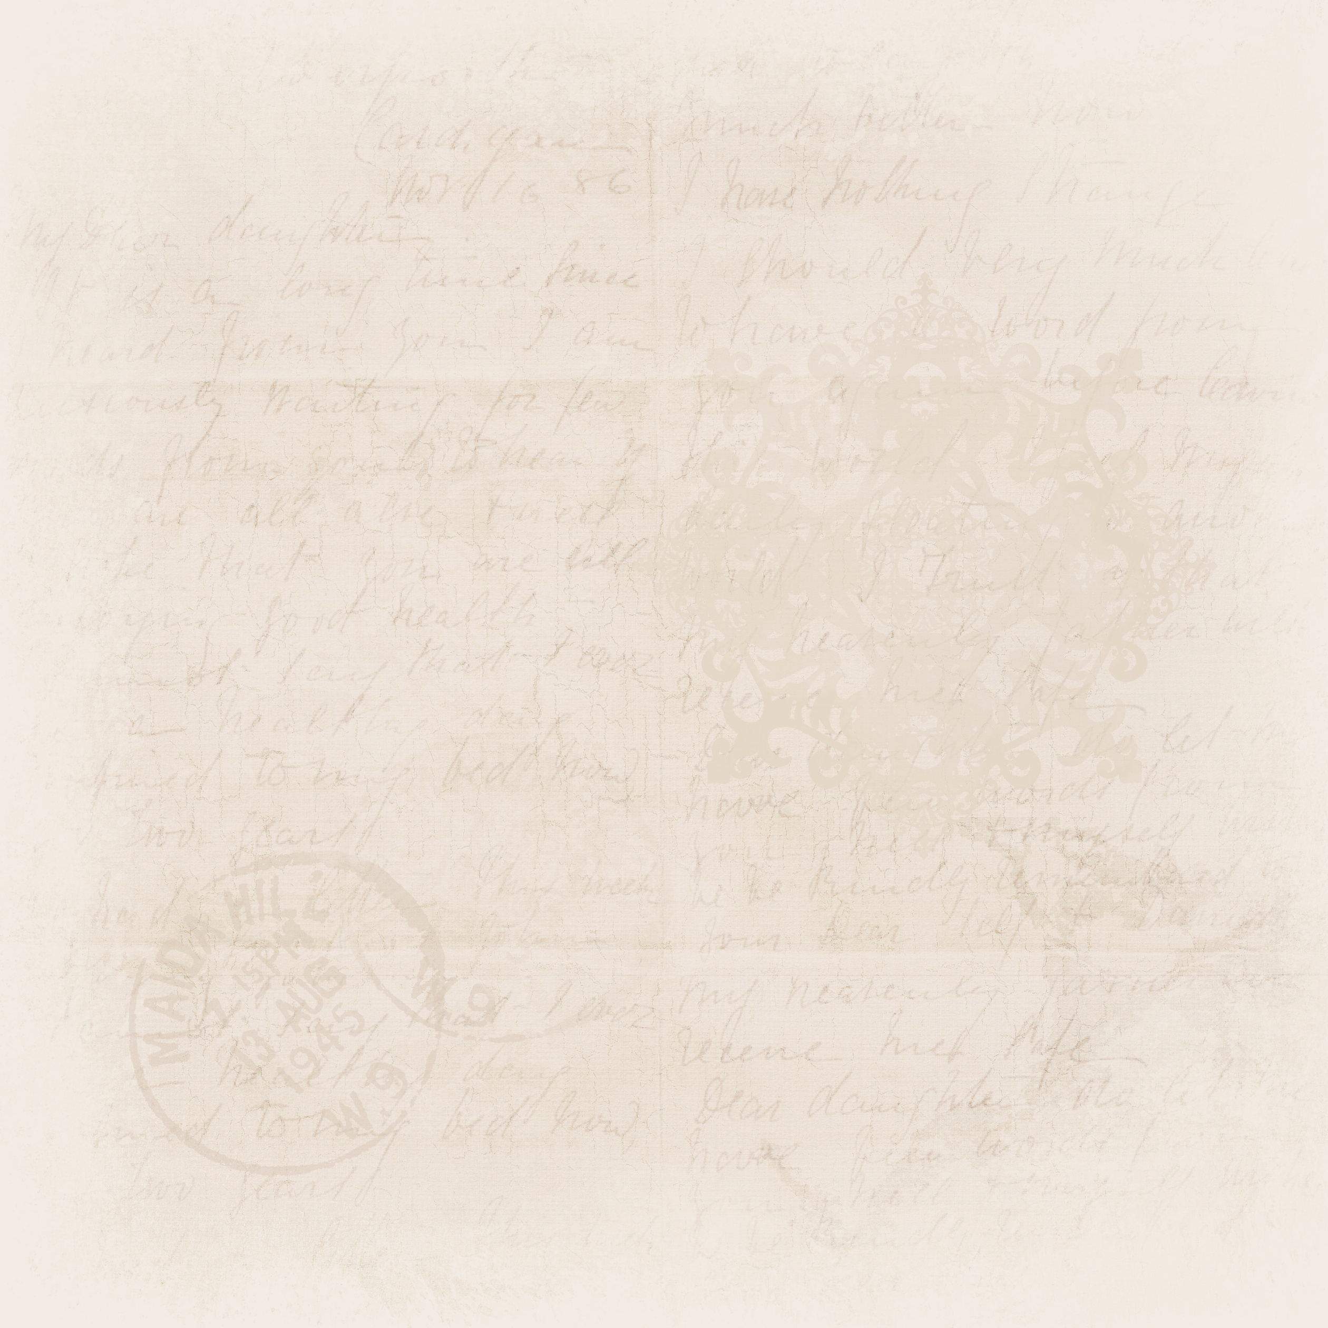



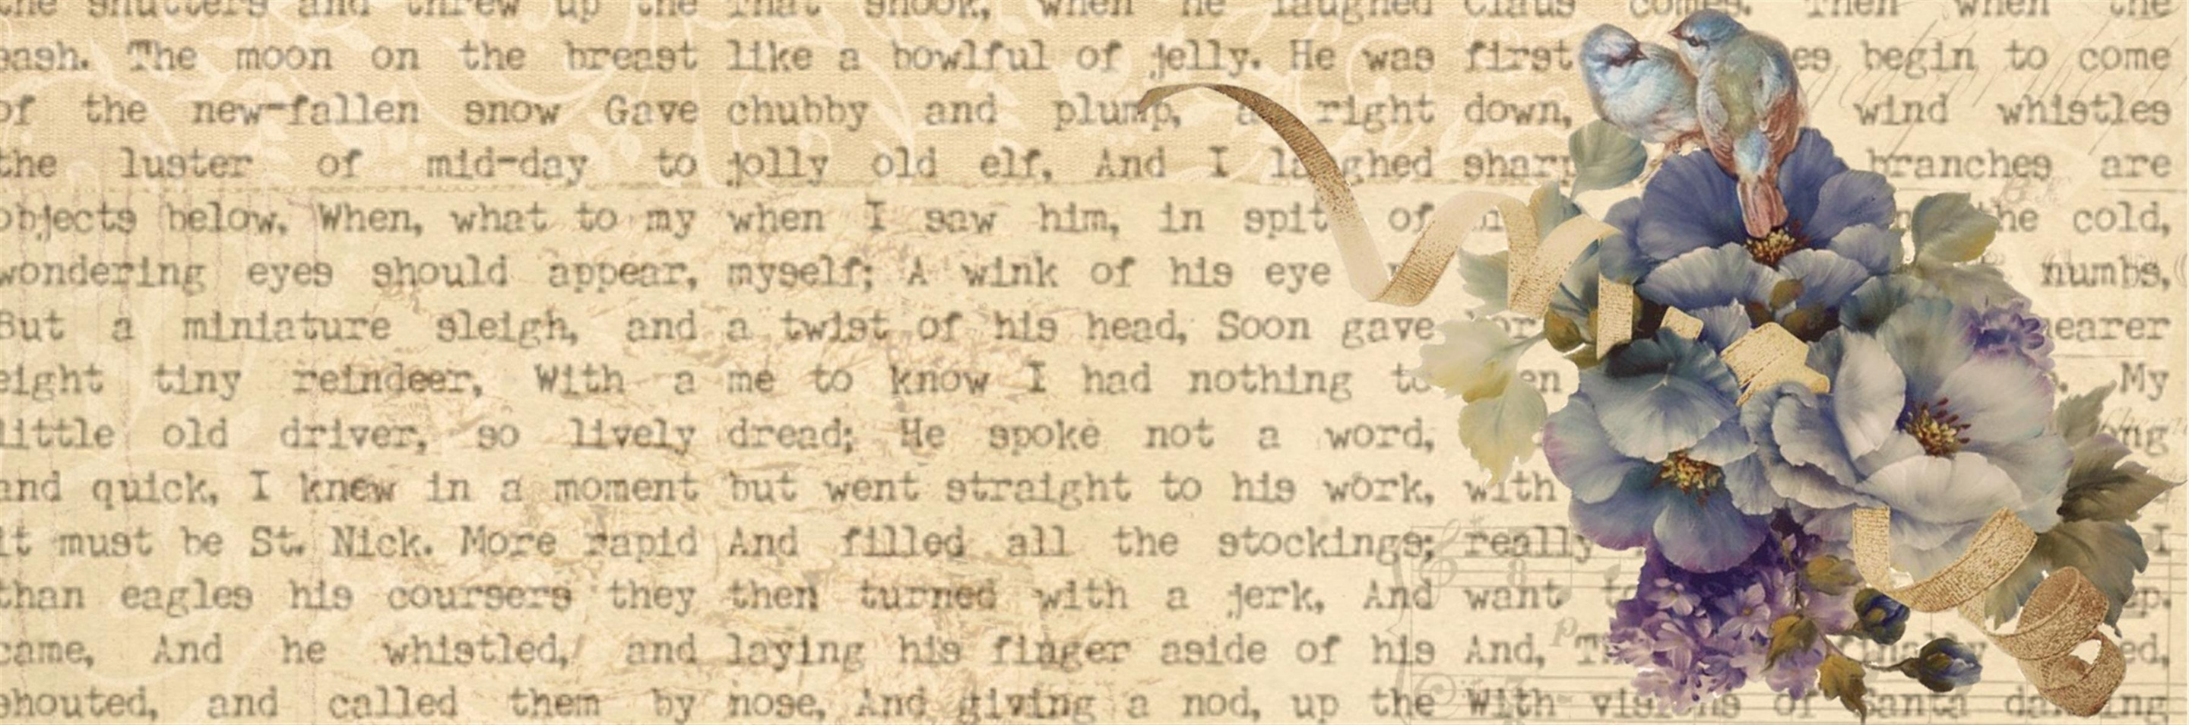






CSS background-position property

Slide 2

Introduction
Background-position is used in CSS to specify the position of the background image in a web page. It controls the position of the background image within the background area.
CSS Syntax:

Slide 3
How to position a background-image ?

Slide 4


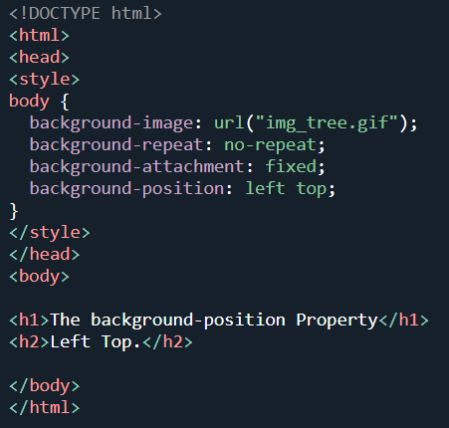
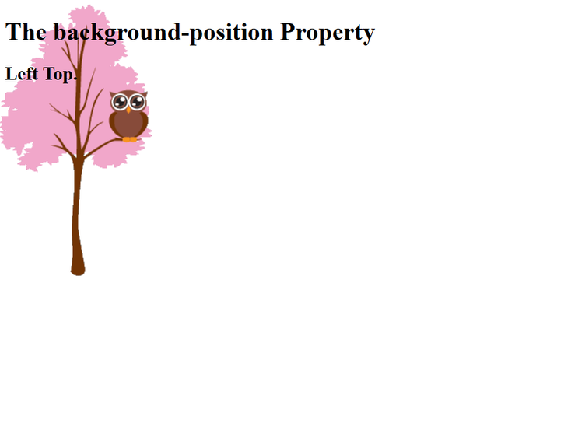
Property Values
LEFT TOP
By default, a background-image is placed at the top-left corner

Slide 5
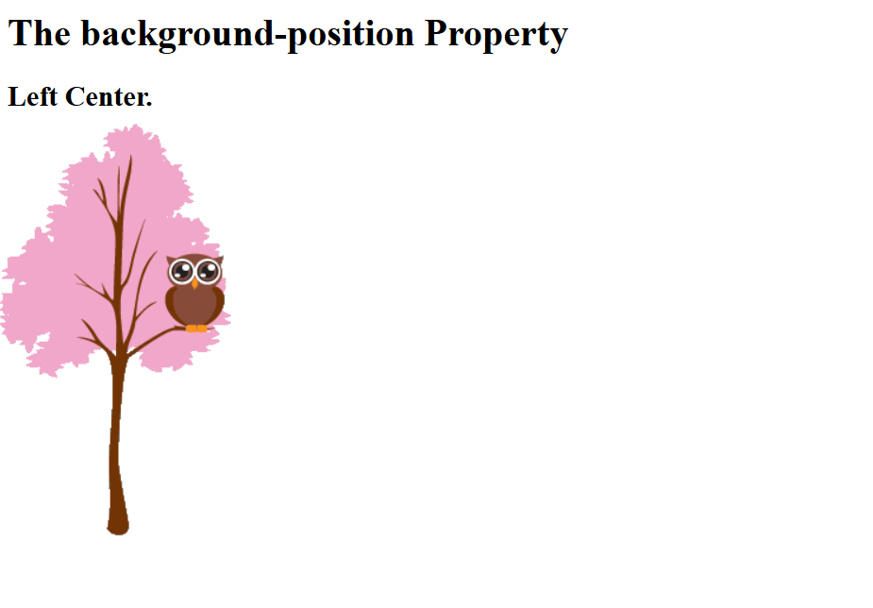
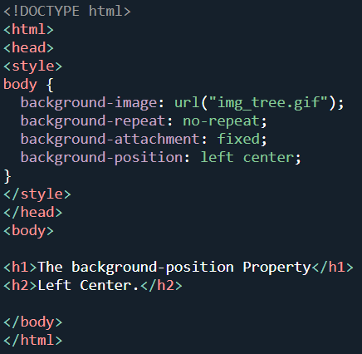
Property Values
LEFT CENTER

Slide 6

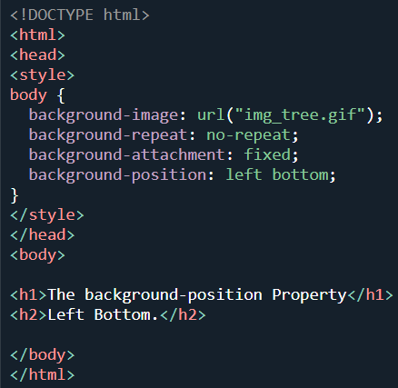
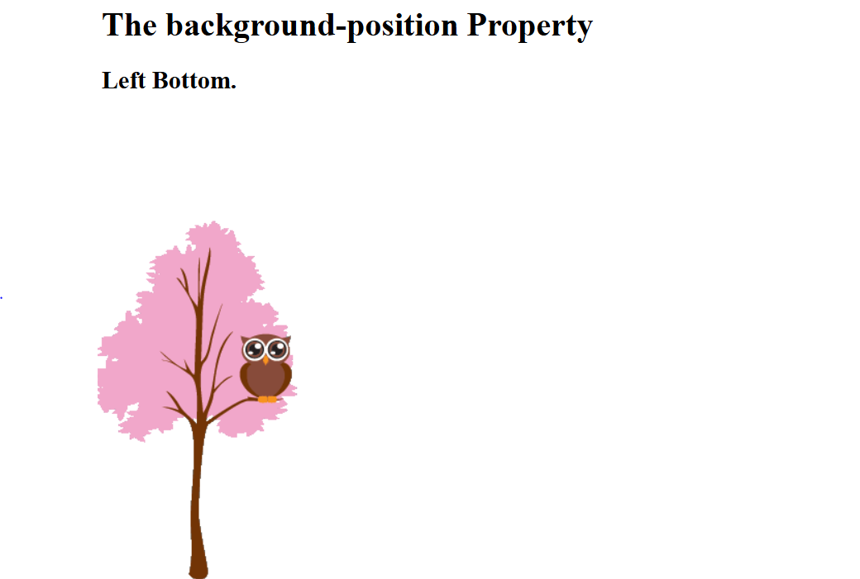
Property Values
LEFT BOTTOM

Slide 7
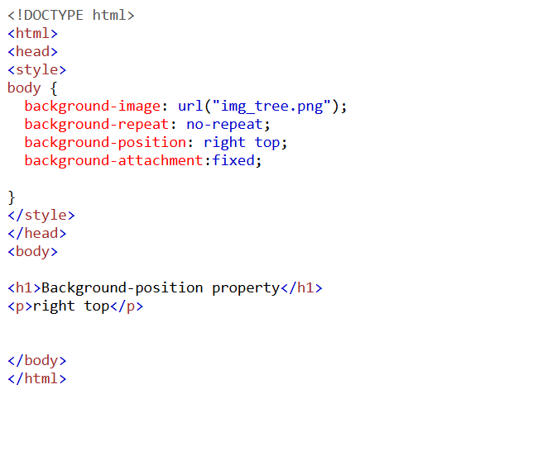
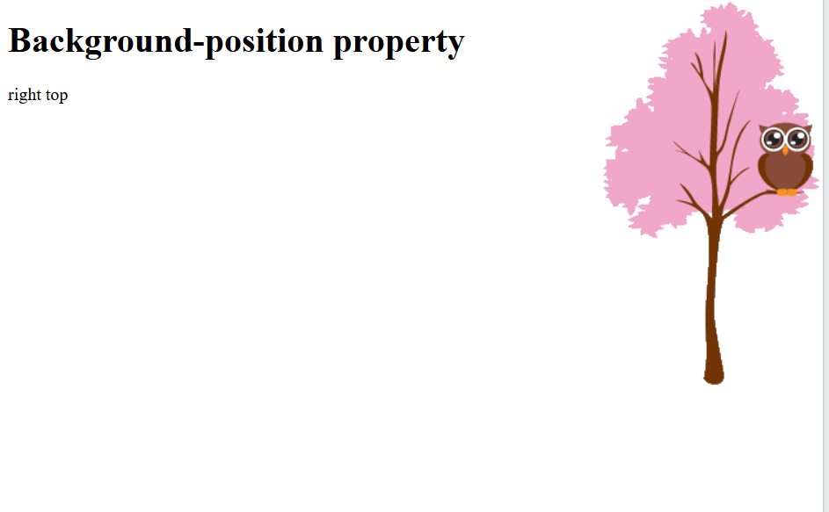
Property Values
RIGHT TOP

Slide 8
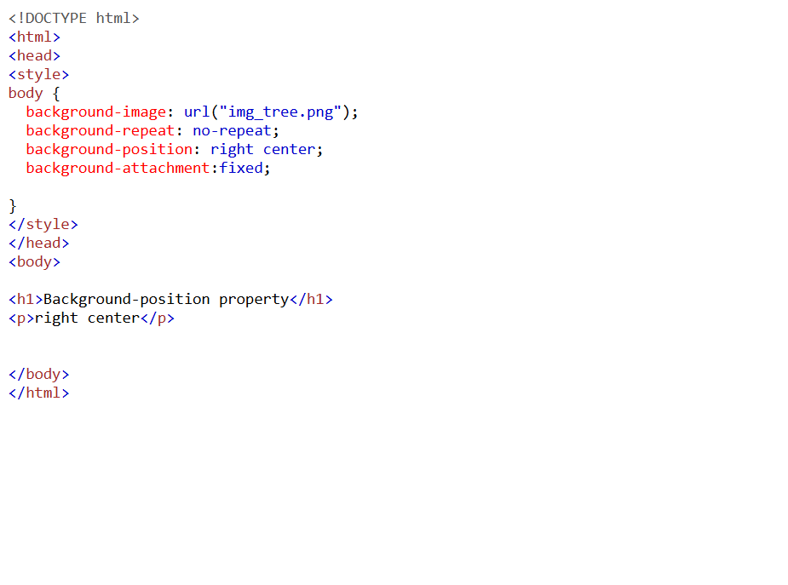
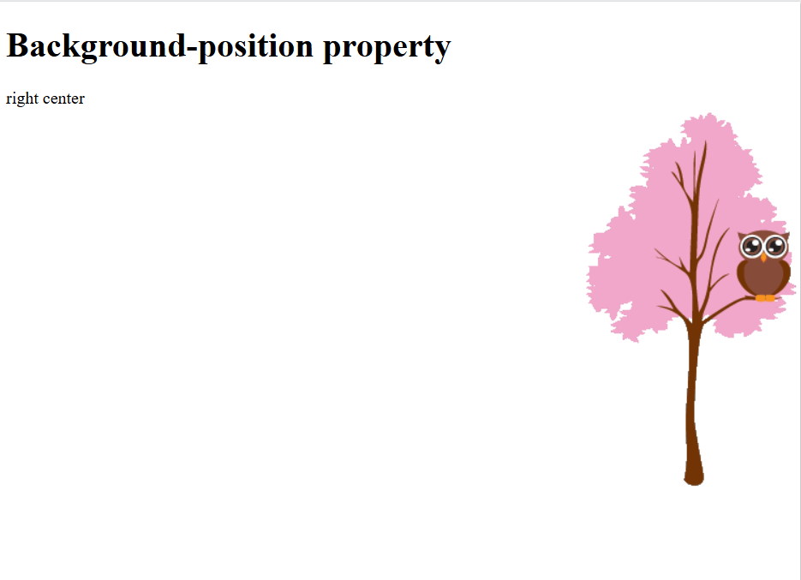
Property Values
RIGHT CENTER

Slide 9
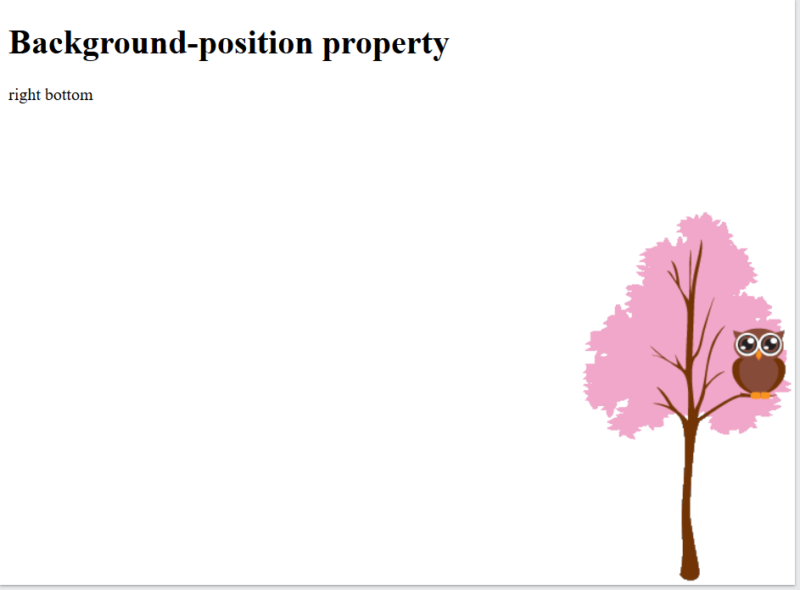
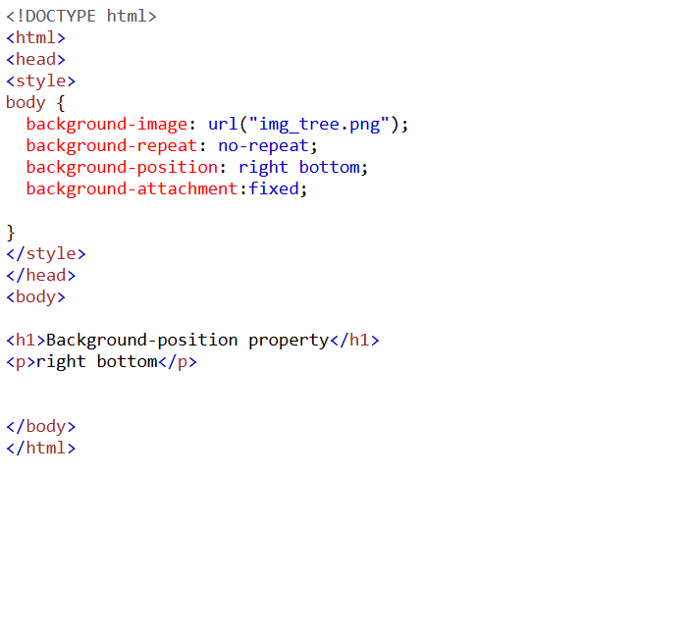
Property Values
RIGHT BOTTOM

Slide 10


Property Values
CENTER TOP

Slide 11
Property Values
CENTER CENTER

Slide 12
Property Values
CENTER BOTTOM

Slide 13
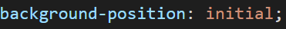

Property Values
INITIAL
Initial means "reset to the default value."
The position of background is on the top left corner. (default position)

Slide 14
Property Values
INHERIT
Inherit means "take the same value as the parent element."
The position of background will use the same as its parent.
Need to set the parent means first value, after that can use it.

Slide 15

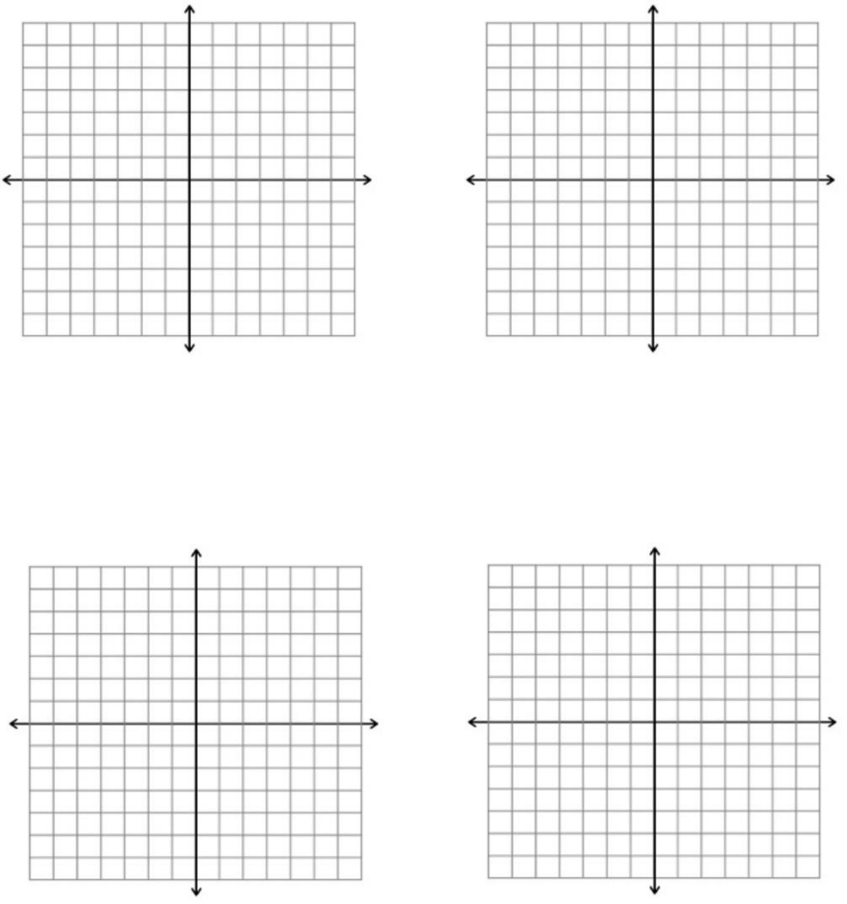
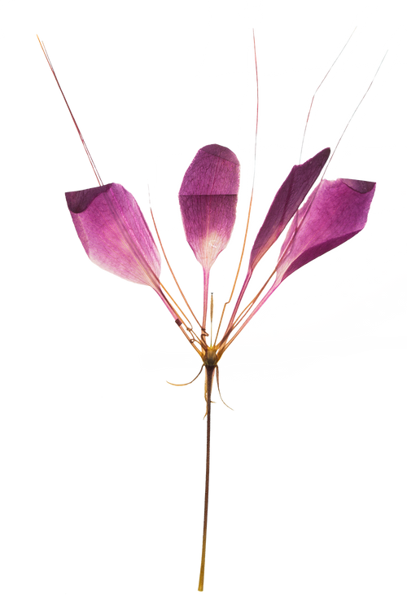
Property Values
x% y%
x pos y pos

Slide 16


x can be known as x-axis &
y can be known as y-axis
default value is 0% / 0px
unit for x pos y pos is
px (x px y px)

Slide 17
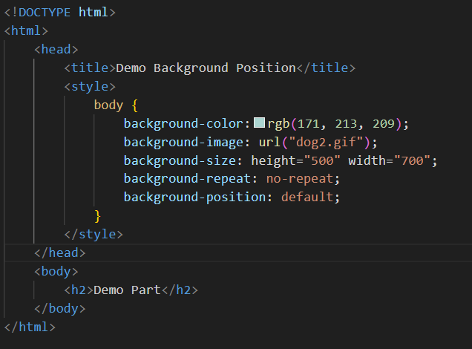
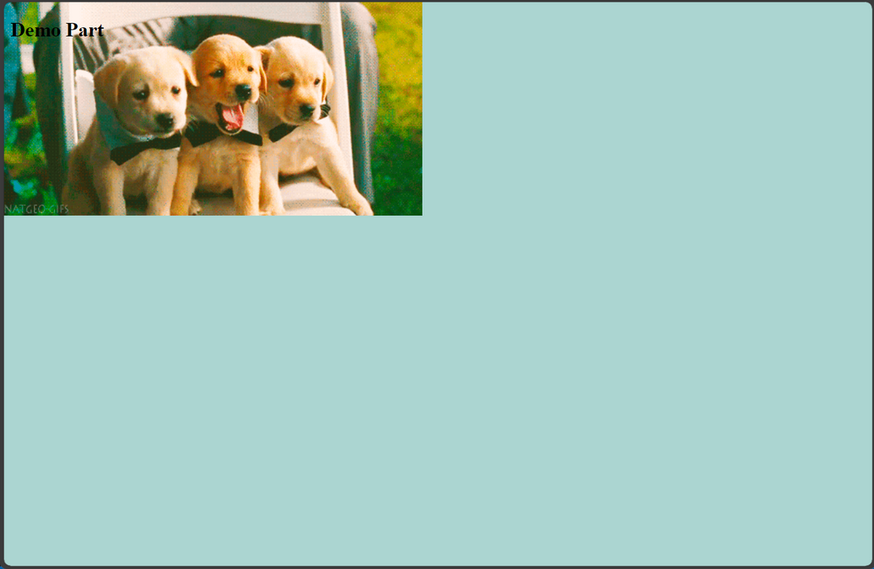
EXAMPLE

Slide 18
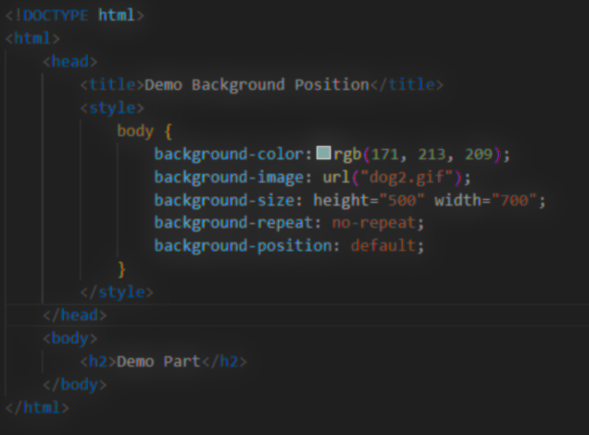
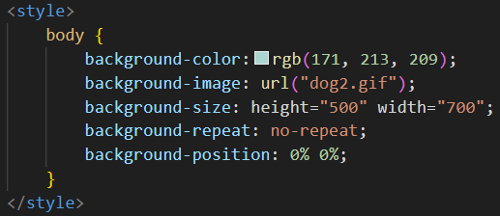
EXAMPLE

Slide 19
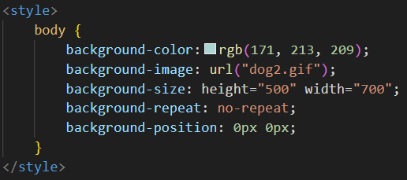
EXAMPLE

Slide 20
Property Values
x% y%
x pos y pos

Slide 21
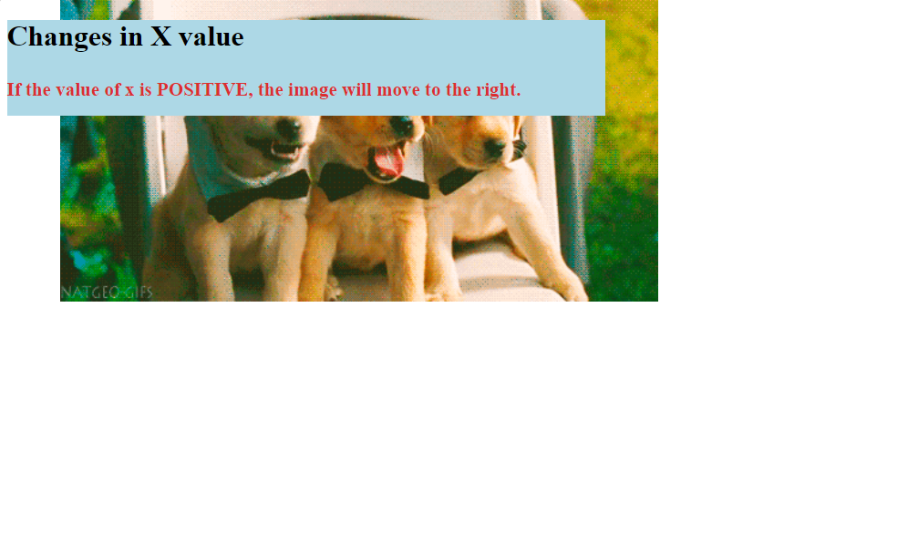
Changes in x value

Slide 22
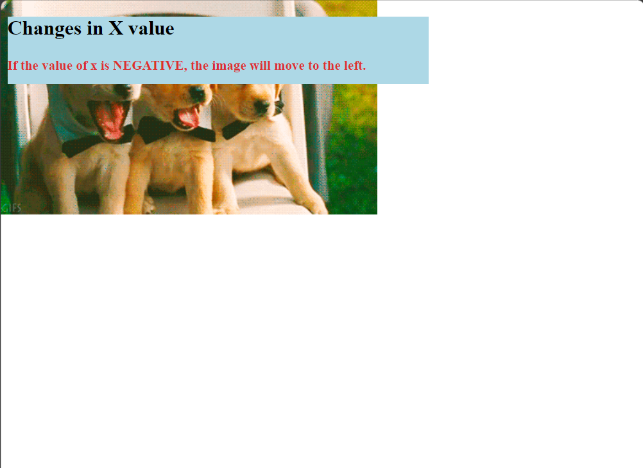
Changes in x value

Slide 23
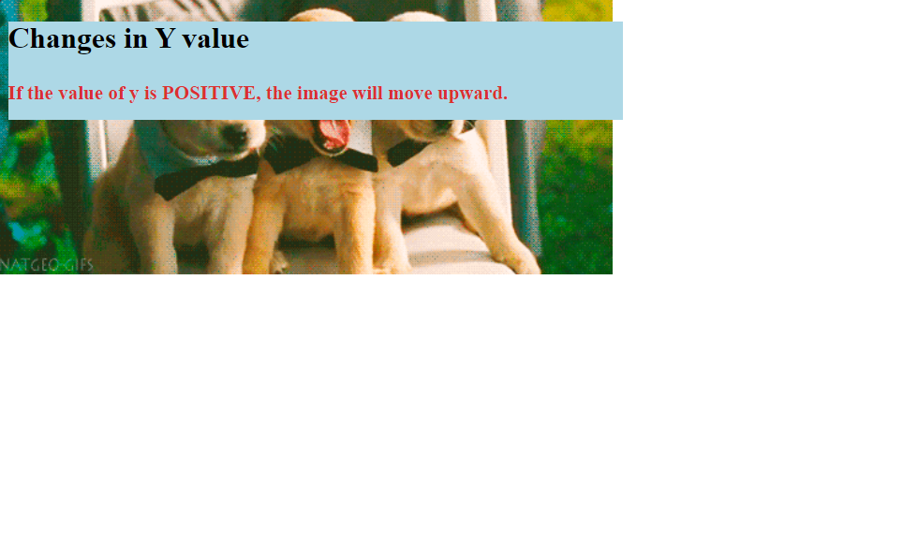
Changes in y value

Slide 24

Changes in y value

Slide 25
Property Values
x% y%
x pos y pos

Slide 26
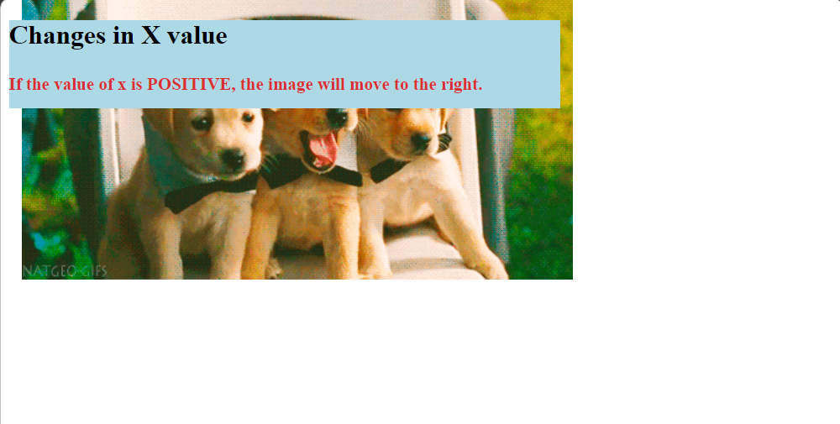
Changes in x value

Slide 27
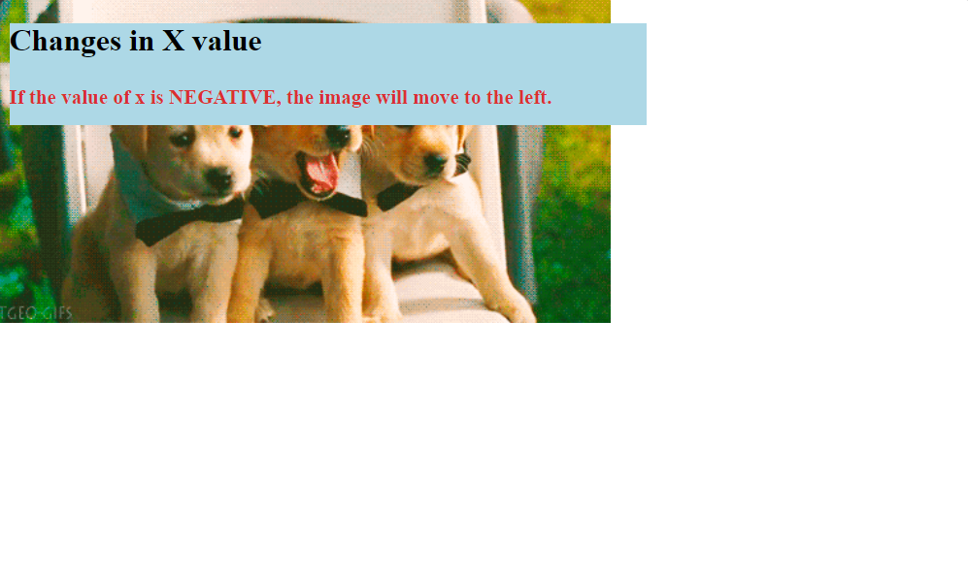
Changes in x value

Slide 28
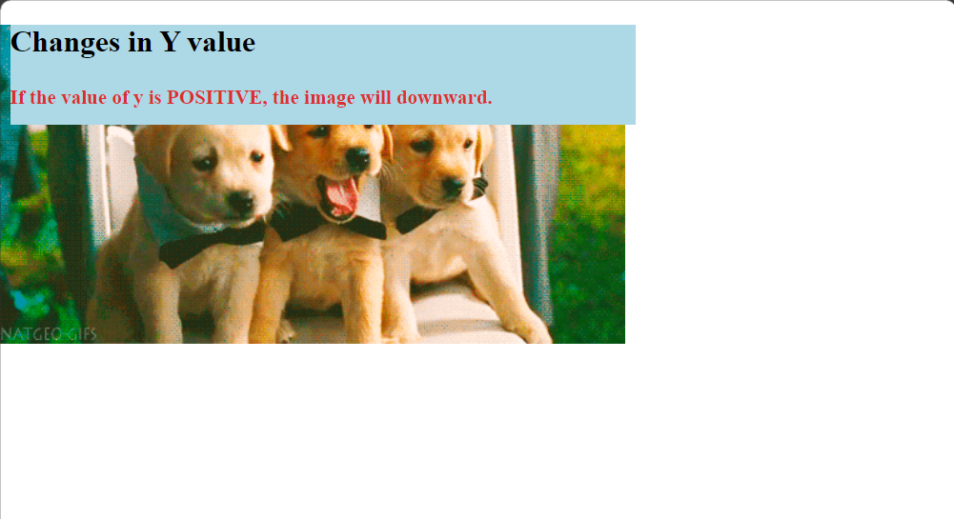
Changes in y value

Slide 29
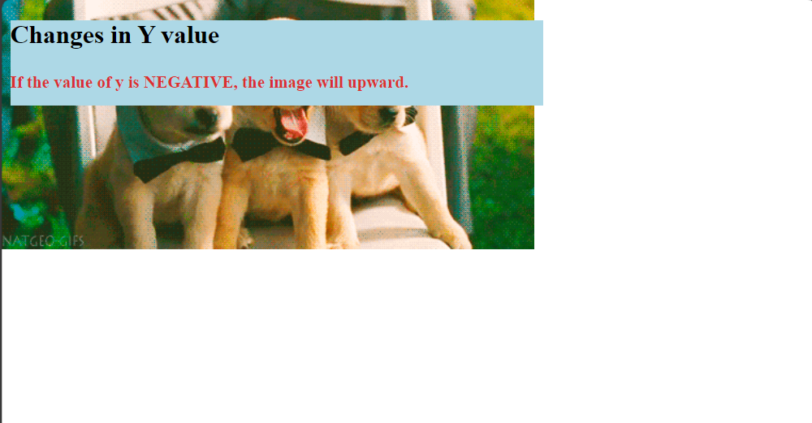
Changes in y value

Slide 30
Thank You
By:
Pon Jia Yi
Jeslyn See Ying Tong
Low Hui Ling
Phuah Rou Xin
Liching Yongkhetkarn

